Slide 1
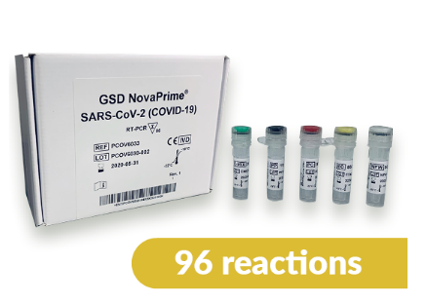
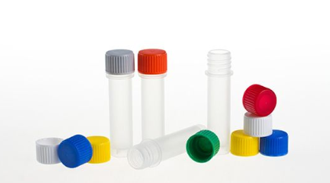
Usage of Vials in Test Kits
Focus on COVID-19 test kits

Slide 2
Table of Contents
Manual vs. Automated Testing
Overview of Test Kits
PCR-Tests
Antibody Tests
Immunoblot Tests
Other Tests
3. Production/Filling Process of Test Kits
4. Racks/Reagent Carrier
1、手动vs自动化测试
2、试剂盒概述
A PCR 检测
B 抗体检测
C 免疫印迹检测
D 其他检测
3、试剂盒的生产及灌装过程
4、架子/试剂架

Slide 3
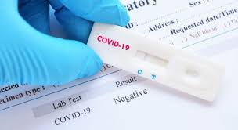
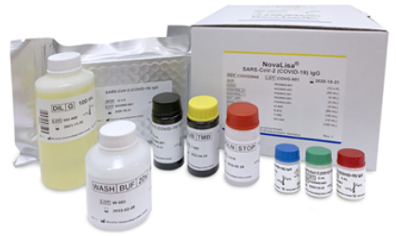
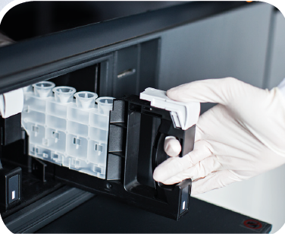
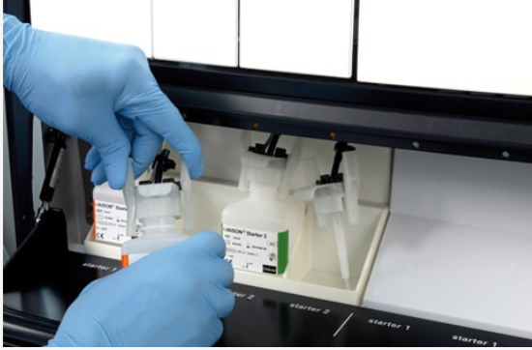
1. Manual Testing vs. Automated Testing
Manual Testing
Automated Testing
Utilizes rapid test kits (small, light weight testing equipment)
PCR tests
ELISA (antibody)
Immunoblot (test stripes)
For use at Point-of-Care facilities
Vials are required for reagents
Zinsser Micro Polyvials
Zinsser Polyvials V
Zinsser Dropper bottles (Qualydrops)
Test kits also utilized in automated instrumentation
Real time PCR
CLIA (Chemiluminescence immunoassay),
e.g. Diasorin test kits
ELISA
Target application for Zinsser vials
Big scale, high trough-put testing in automated instrumentation (e.g. Roche Cobas全自动生化分析仪)
Used in big laboratories
Reagents filled in big container
No need for small sized vials

Slide 4
2. Overview of different kinds of test kits
Nucleic Acid based tests (Detect acute infection of Sars-Cov-2)
PCR tests / rt-PCR and related nucleic acid isolation kits
Sequencing assays
Antibody tests (Detect past infections and an active immune response to the virus)
ELISA (enzyme linked immunosorbent assay)
RIA (radio immunoassay)
CLIA (Chemiluminescence immunoassay): Fully automated analyzers
Microfluidic tests
POC instruments in general
Immunoblot tests (Antibody): Testing strips
Other

Slide 5
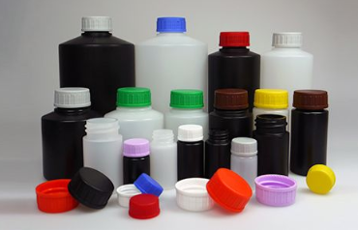
A) PCR Tests
Detection of RNA of the novel Coronavirus (SARS-CoV-2) in human respiratory samples. Detect acute infection of Sars-Cov-2
http://virotech.co.nz/
Test kit content from Virotech (customer of Zinsser)
RT-PCR Enzyme Mix
Primer-Probe-Mix
Extraction Control
Positive Control
Nuclease Free Water
Equivalent Zinsser vials:
Micro Polyvials
Polyvials V
Micro Polyvials: 1,5mL
Polyvials V: 4mL to 250mL

Slide 6
B) Antibody Tests (Serology Tests)
Detection of IgG, IgA and IgM antibodies to SARS-CoV-2 virus in human serum
For ease of use on any open ELISA automation platform
Test kit content (Virotech):
Equivalent Zinsser vials:
Polyvials V (4mL to 250mL)
Leakage free storage of reagents
Notes:
Ordered Poly vials V (50ml, 20ml, 4ml, 100ml,10ml)

Slide 7
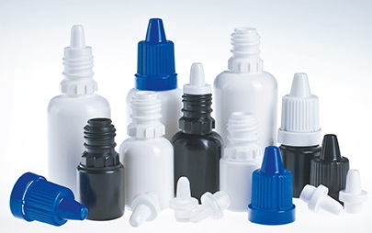
C) Immunoblot Tests
Tests conducted with testing stripes
Applicable Zinsser vials:
Dropper bottles (Qualydrops) for precise drops
Available volumes of 3 mL, 5 mL, 10 mL, 20 mL and 30 mL
测试条进行的检测

Slide 8
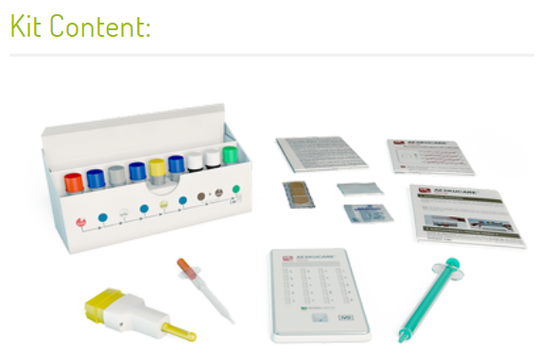
D) Other Test Kits
AESKU Allergy point-of-care test kits https://www.aesku.com/ 变态/过敏反应的检测试剂盒
Equivalent Zinsser vials:
Micro Polyvials
Polyvials V
Micro Polyvials: 1,5mL
Polyvials V: 4mL to 250mL

